Slide 1
V3.1.1
New Features and Processes

Slide 2
Enhancements
Store Stats Report
Report Date Range

Slide 3
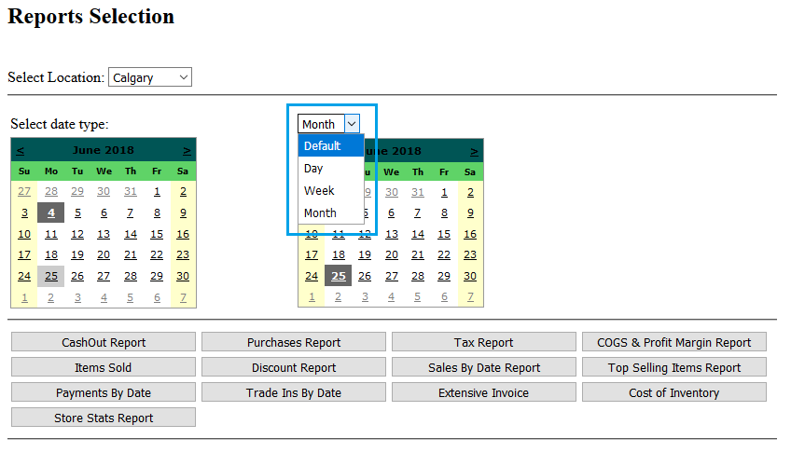
Report Date Range
To help select date ranges, you can now use the date type dropdown box (Blue).
Using the screenshot as an example, the left calendar’s selected date is the 4th of June while the right calendar’s date is the 25th of June. When “Week” is selected as the date range, the report will be for the 3rd of June to the 30th. If “Month” is selected, the range would be from the 1st of June to the 30th of June.

Slide 4
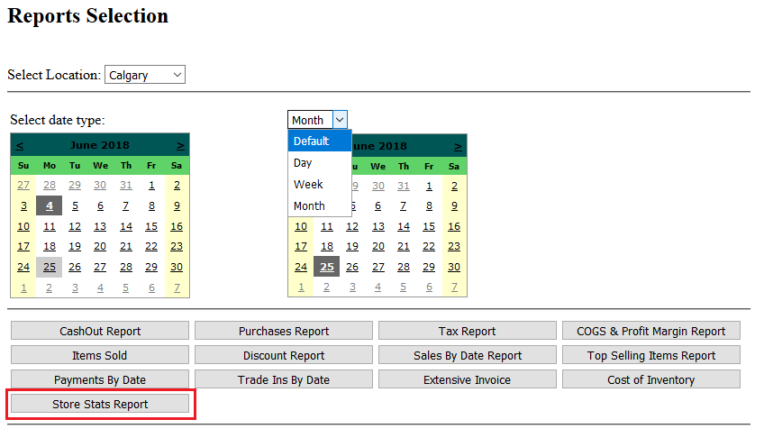
Store Stats Report
This report is unique in that it will show its data in either a daily, weekly or monthly format and you are not required to select a location as it will return results for all locations.
Attached to this presentation are example reports

Slide 5
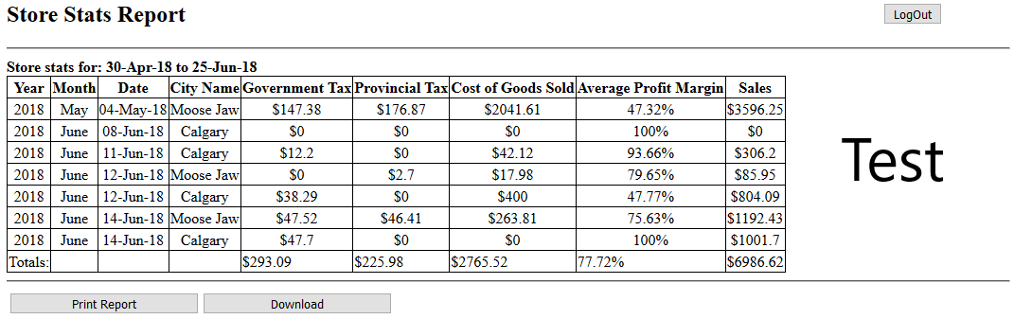
Example Daily Report

Slide 6
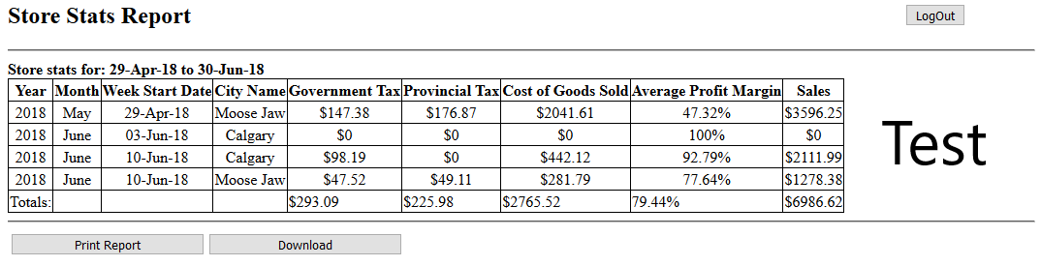
Example Weekly Report

Slide 7
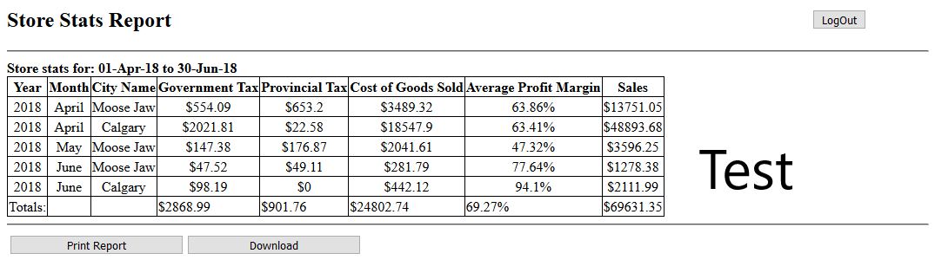
Example Monthly Report

